Slide 1
Application Delivery Fundamentals 2.0 B: Java
Spring Boot

Slide 2
Spring Boot
Goals
Provide a radically faster and widely accessible getting started experience
Be opinionated out of the box, but get out of the way quickly as requirements start to diverge from the defaults
Provide a range of non-functional features that are common to large classes of projects (e.g. embedded servers, security, metrics, health checks, externalized configuration)
Absolutely no code generation and no requirement for XML configuration

Slide 3
Spring Boot
Goals
To avoid defining more Annotation Configuration(It combined some existing Spring Framework Annotations to a simple and single Annotation)
Spring Boot avoid writing lots of import statements
To provide some defaults to quick start new projects within no time.

Slide 5
Spring Boot

Slide 6
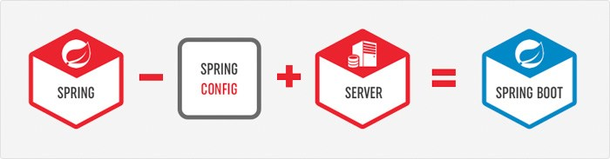
SpringBoot = a Sub-Project of SpringFramework

Slide 7
SpringBoot = a Sub-Project of SpringFramework

Slide 9
Spring Boot Modules

Slide 10
Spring Boot Components
Spring Boot Auto Configure
Module to auto configure a wide range of Spring projects.
It will detect availability of certain frameworks (Spring Batch, Spring Data JPA, Hibernate, JDBC).
When detected it will try to auto configure that framework with some sensible defaults, which in general can be overridden by configuration in an application.properties/yml file.

Slide 11
Spring Boot Components
Spring Boot Core
The base for other modules, but it also provides some functionality that can be used on its own, eg. using command line arguments and YAML files as Spring Environment property sources and automatically binding environment properties to Spring bean properties (with validation).

Slide 12
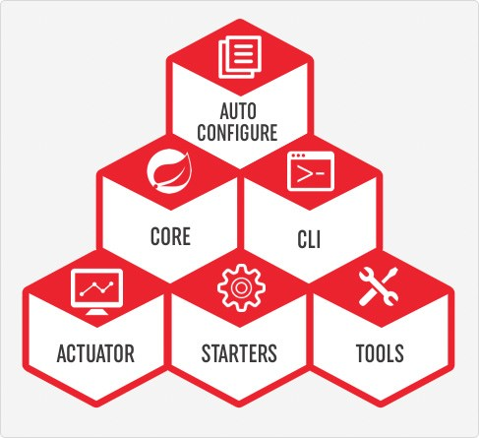
Spring Boot Components
Spring Boot CLI
A command line interface, based on ruby, to start/stop spring boot created applications.

Slide 13
Spring Boot Components
Spring Boot Actuator
This project, when added, will enable certain enterprise features (Security, Metrics, Default Error pages) to your application.
As the auto configure module it uses auto detection to detect certain frameworks/features of your application.
For an example, you can see all the REST Services defined in a web application using Actuator

Slide 14
Spring Boot Components
Spring Boot Starters
Different quick start projects to include as a dependency in your maven or gradle build file.
It will have the needed dependencies for that type of application. Currently there are many starter projects and many more are expected to be added.

Slide 15
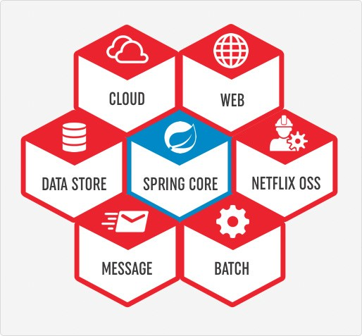
Spring Boot Components
Spring Boot Starters

Slide 16
Spring Boot Components
Spring Boot Tools
The Maven and Gradle build tool as well as the custom Spring Boot Loader (used in the single executable jar/war) is included in this project.

Slide 17
Spring Boot Installation
Requirements:
• Java (>=1.6) + (for Java projects)
• Maven 3.2+ or Gradle 1.12+
! Spring Tool Suite has some nice features for Java projects
! Download: https://start.spring.io/spring.zip
! Unzip the distro (approx. 10MB), and find bin/ directory
! (You can also install Spring Boot CLI with gvm, brew or MacPorts)

Slide 18
Servlet Containers
Name | Servlet Version
Tomcat 8.5 | 3.1
Jetty 9.4 | 3.1
Undertow 1.4 | 3.1

Slide 19
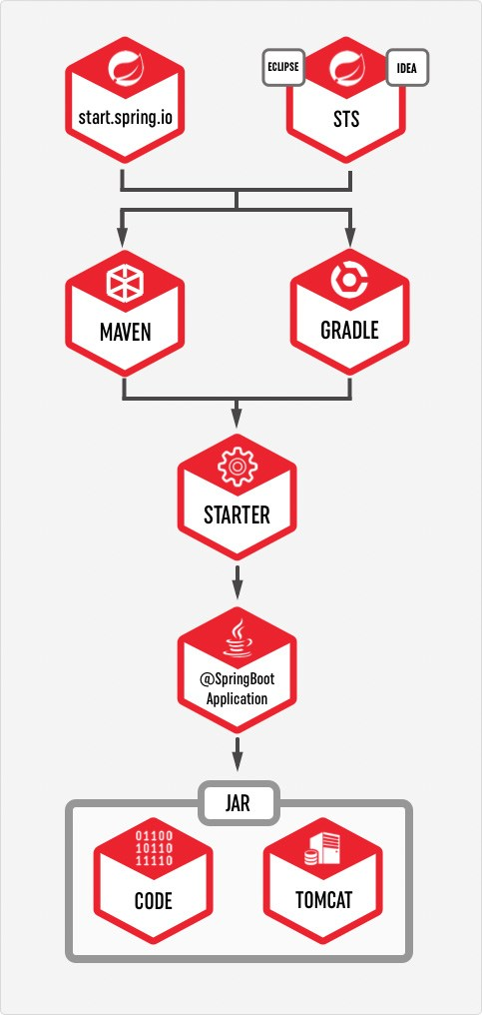
How to use Spring Boot

Slide 20
What is Pivotal
Vmware and EMC spin out
• vFabric from vmware
• Greenplum MPP DB and Hadoop from EMC
• Agile development acquisitions Pivotal Labs and Xtreme Labs
Paul Maritz CEO
• Former CEO vmware.
Custodian of various OSS projects including Spring
• and RabbitMQ, Redis, CloudFondry, Groovy/Grails, …
Commercial interests in Big/Fast Data, PaaS, Enterprise tooling
• Spring is an enabling technology

Slide 21
Installing the Spring Boot CLI
The Spring Boot CLI (Command Line Interface) is a command line tool that you can use to quickly prototype with Spring.
It lets you run Groovy scripts, which means that you have a familiar Java-like syntax without so much boilerplate code.
You do not need to use the CLI to work with Spring Boot, but it is definitely the quickest way to get a Spring application off the ground.

Slide 22
Manual Installation
You can download the Spring CLI distribution from the Spring software repository:
spring-boot-cli-2.0.4.RELEASE-bin.zip
spring-boot-cli-2.0.4.RELEASE-bin.tar.gz

Slide 23
Manual Installation
set PATH=D:\spring-boot-cli- 1.2.3.RELEASE\bin;%PATH%
spring –version
Spring --help
@RestController
class HelloWorld {
@RequestMapping("/")
String hello() {
"Hello JournalDev World."
}
}
Name this file as HelloWorld.groovy. Here “.groovy” extension is mandatory.

Slide 24
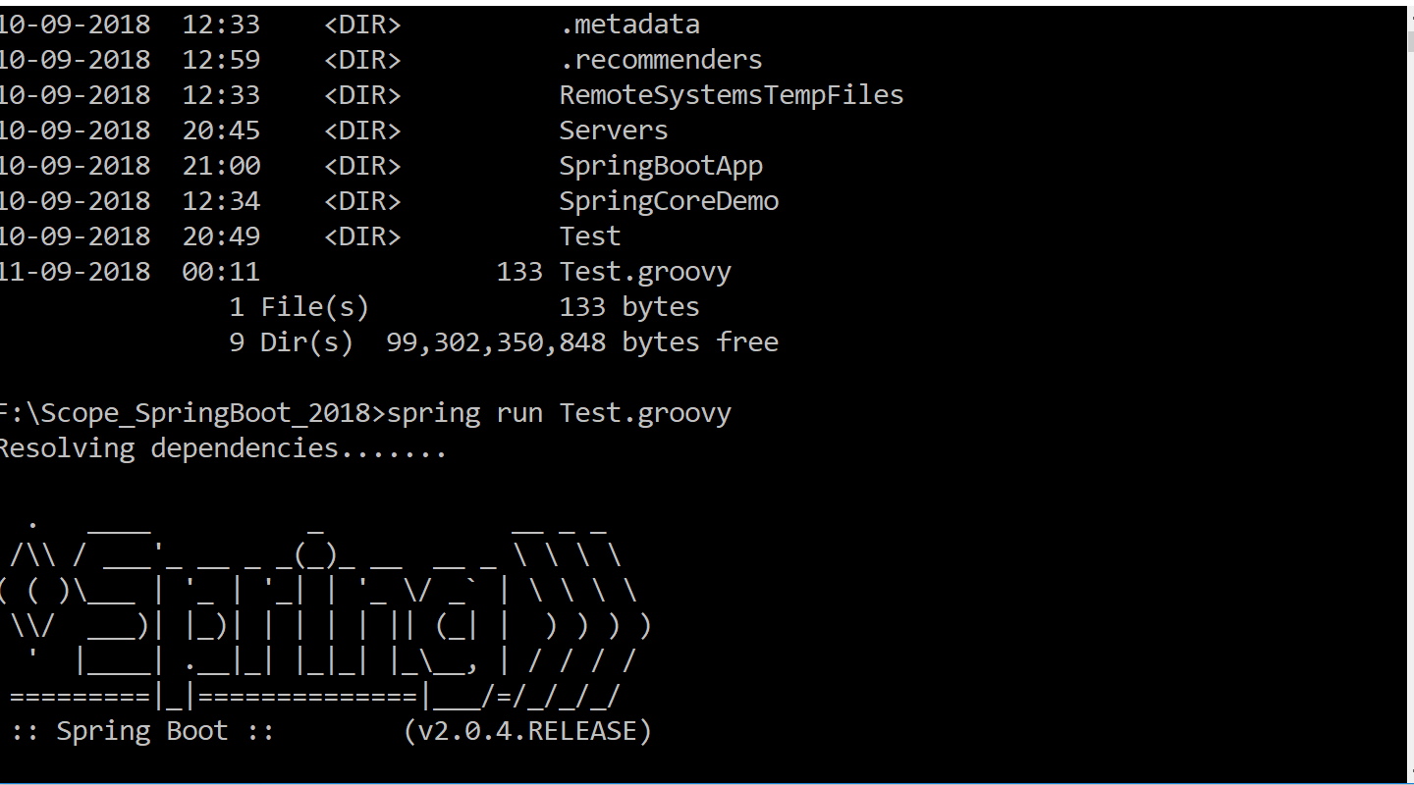
Manual Installation

Slide 25
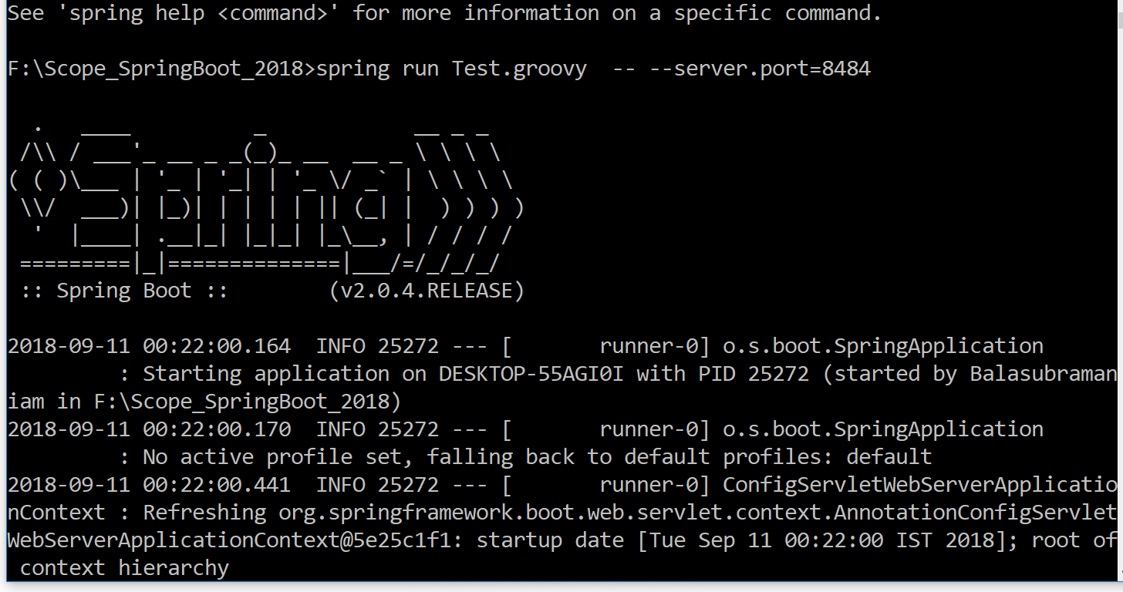
Manual Installation

Slide 26
Packaging For Production
Maven plugin (using spring-boot-starter-parent):
! Gradle plugin:
<plugin>
<groupId>org.springframework.boot</groupId>
<artifactId>spring-boot-maven-plugin</artifactId>
</plugin>
$ mvn package
apply plugin: 'spring-boot'
$ gradle build

Slide 27
Packaging For Production
Packaging For Production
$ java -jar yourapp.jar
! Easy to understand structure
! No unpacking or start scripts required
! Typical REST app ~10Mb
! Cloud Foundry friendly (works & fast to upload)

Slide 28
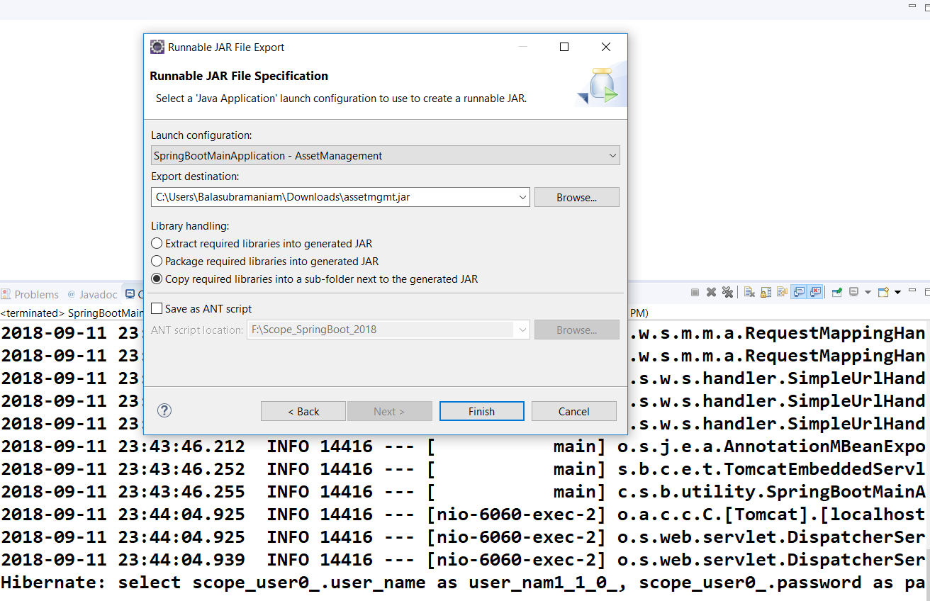

Slide 29
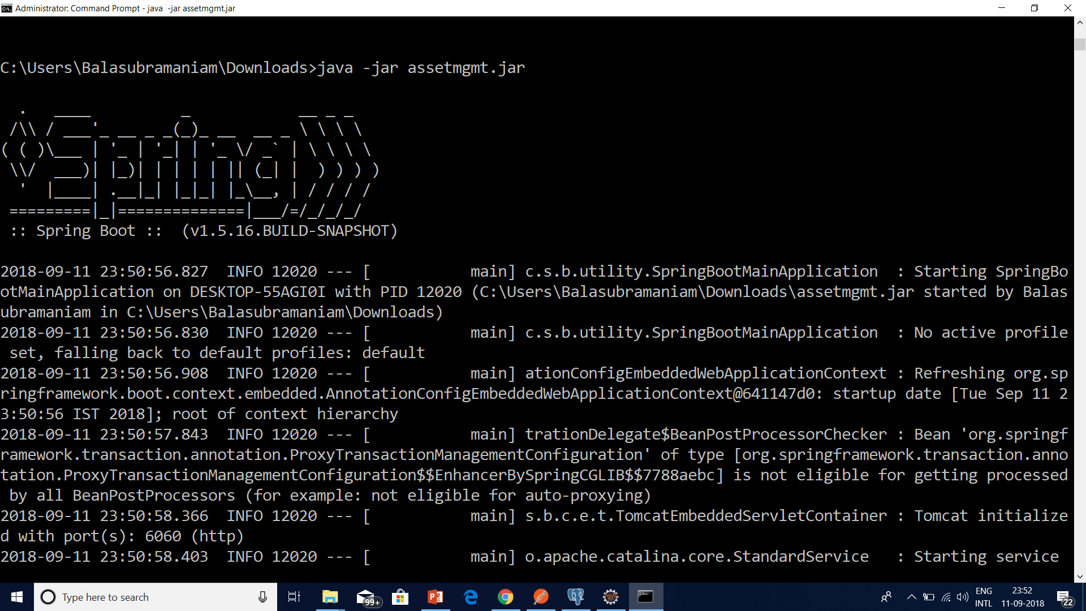

Slide 30
Logging Configuration in Spring Boot
Spring Boot provides support for logging and uses Commons Logging for all internal logging, but leaves the underlying log implementation open.
Default configurations are provided for Java Util Logging, Log4J2 and Logback.
In each case loggers are pre-configured to use console output with optional file output also available.

Slide 31
How to Deploy Spring Boot Application to Cloud Foundry Platform
Cloud Foundry is an open-source platform as a service (PaaS) that provides you with a choice of clouds, developer frameworks, and application services.
It is open source and it is governed by the Cloud Foundry Foundation.
The original Cloud Foundry was developed by VMware and currently it is managed by Pivotal, a joint venture company by GE, EMC and VMware.

Slide 32
Cloud Foundary Providers
Pivotal Cloud Foundry
IBM Bluemix
HPE Helion Stackato 4.0
Atos Canopy
CenturyLink App Fog
GE Predix
Huawei FusionStage
SAP Cloud Platform
Swisscom Application Cloud

Slide 33
Cloud Foundry Installation for Windows
Download the CF Windows installer. It will prompt for the download. Save the zip file distribution.
Unpack the zip file to a suitable place in your workstation.
After successfully unzip operation, double cick on the cf CLI executable.
When prompted, click Install, then Close.

Slide 34
Cloud Foundry Installation for Windows
Verify the installation by opening a terminal window and type cf. If your installation was successful, the cf CLI help listing appears.
This indicates that you are ready to go with any cloud foundry platform from your local workstation.

Slide 35
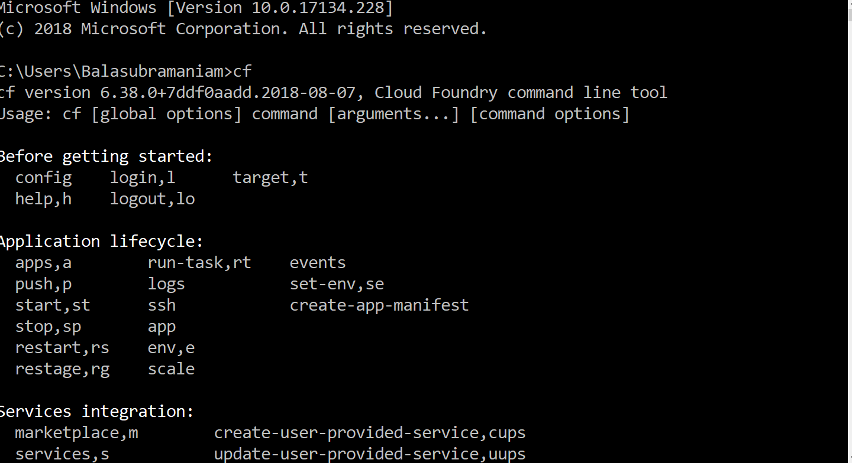

Slide 36
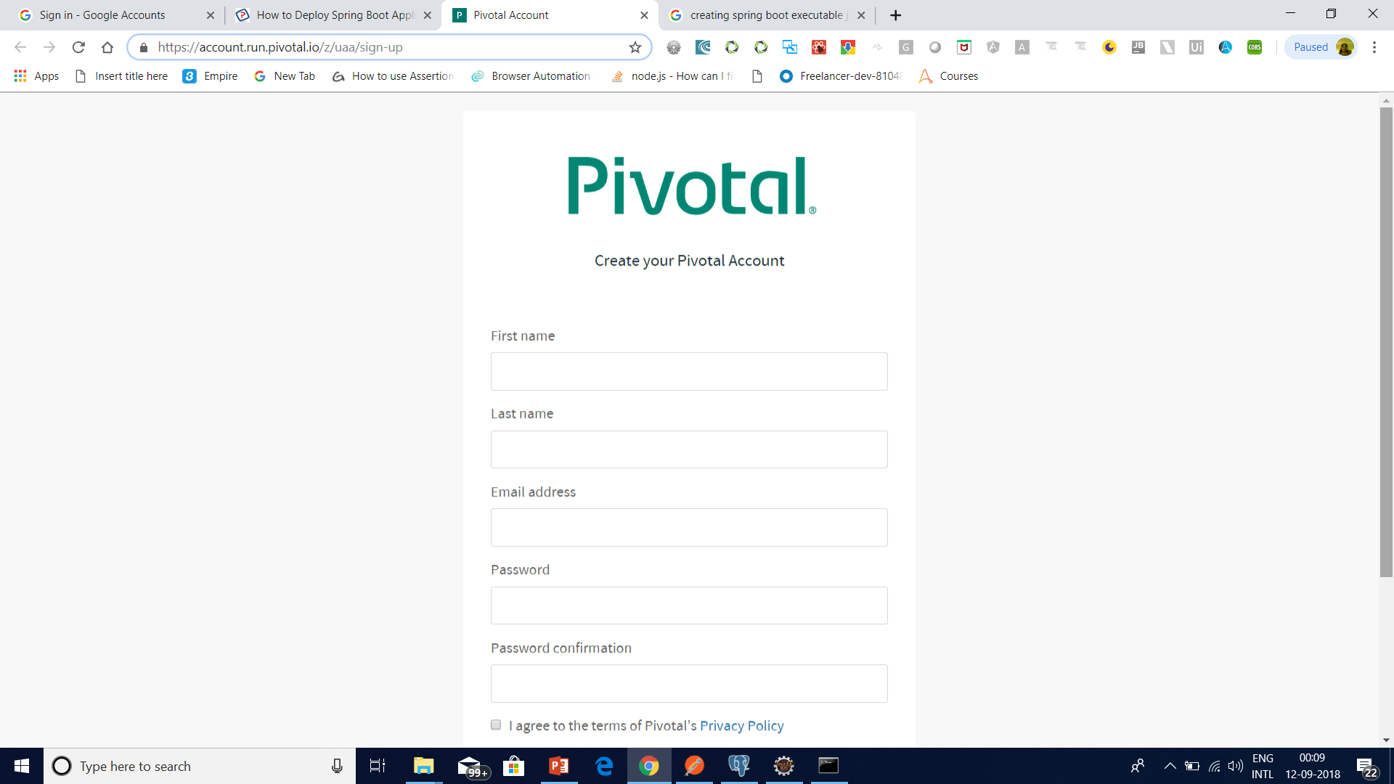

Slide 37
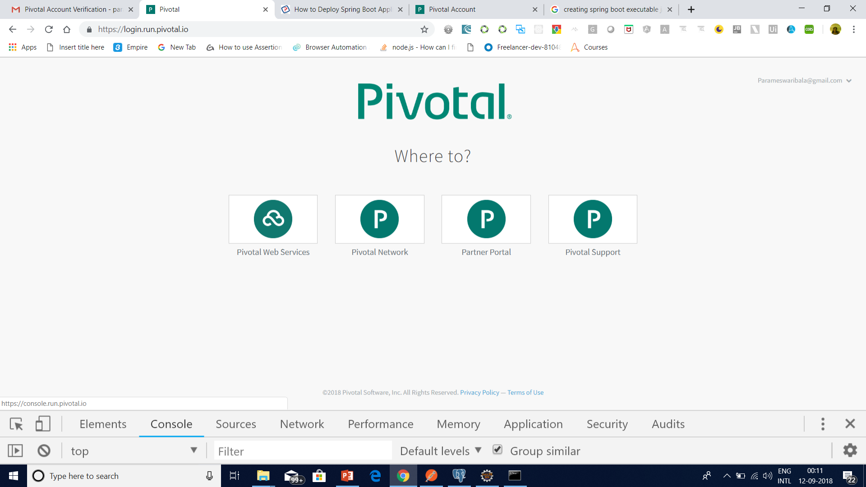

Slide 38
Login and logout from PWS Console using CLI
Login to PWS – We will use cf login -a api.run.pivotal.io
Logout from PWS Console – We will use command cf logout to logout from the platform, once we have all the work done for that session.

Slide 39
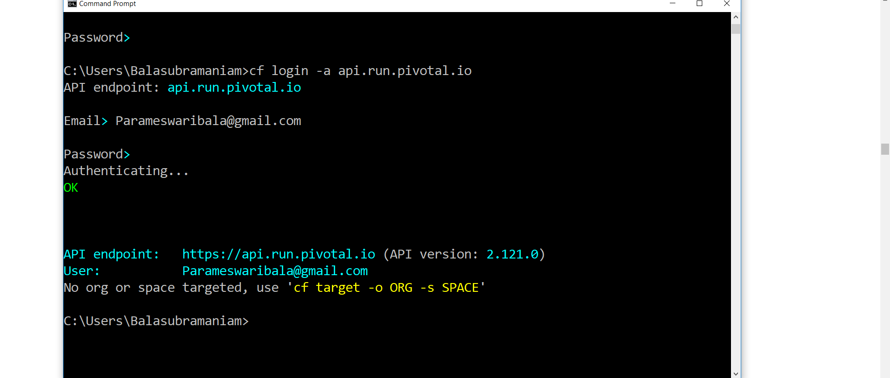

Slide 40
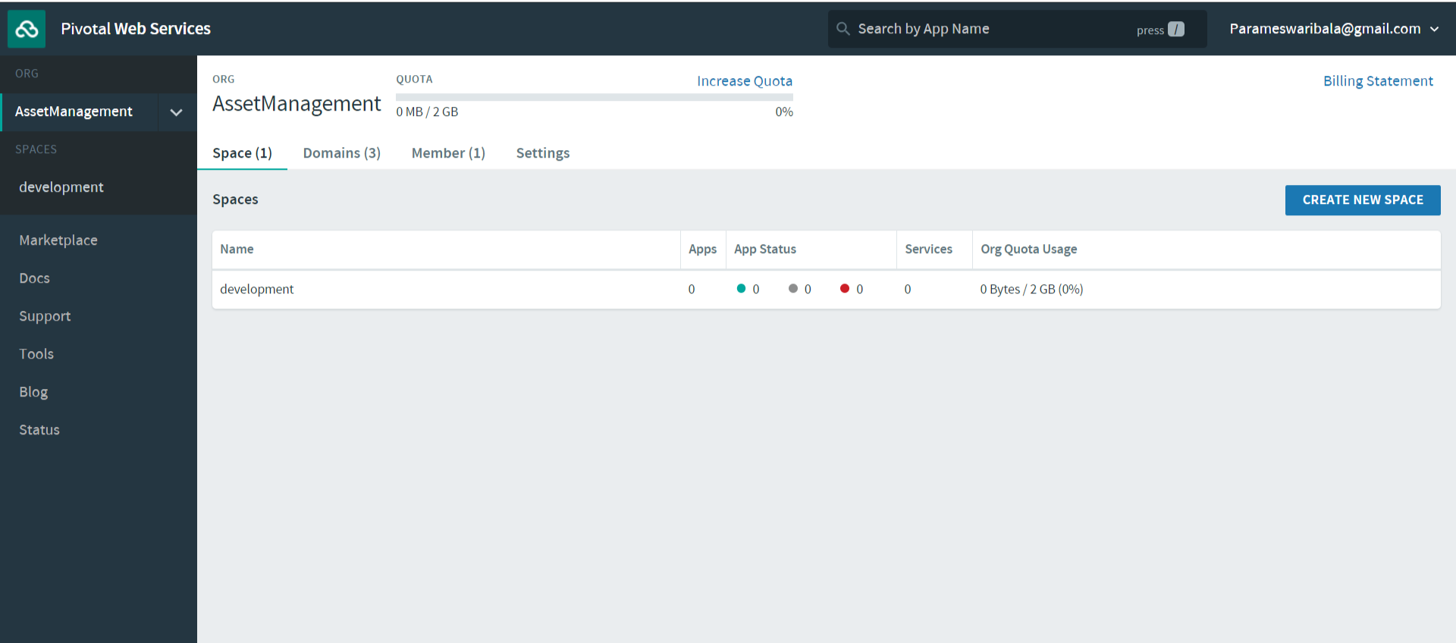

Slide 41
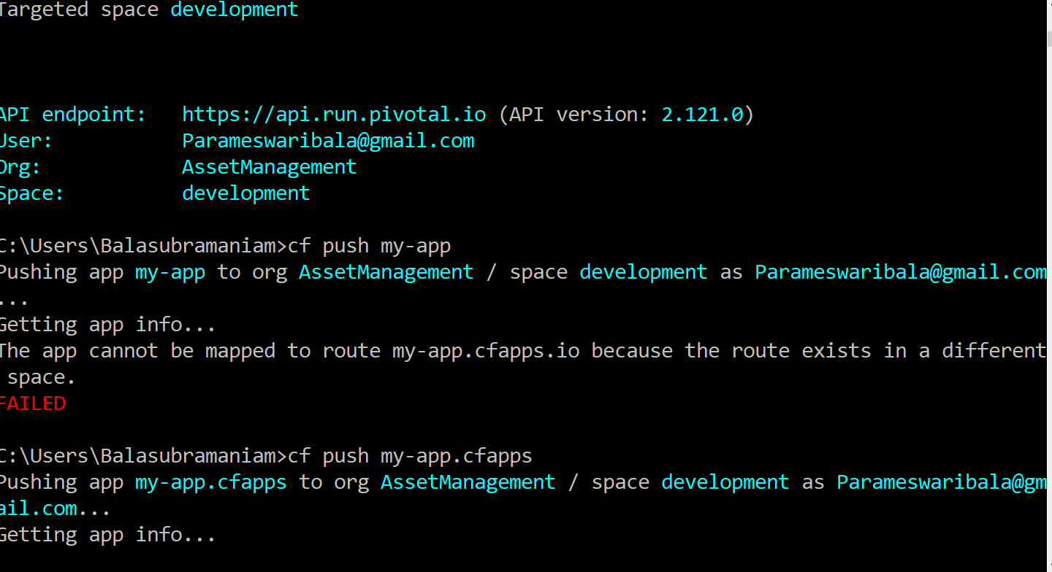

Slide 42
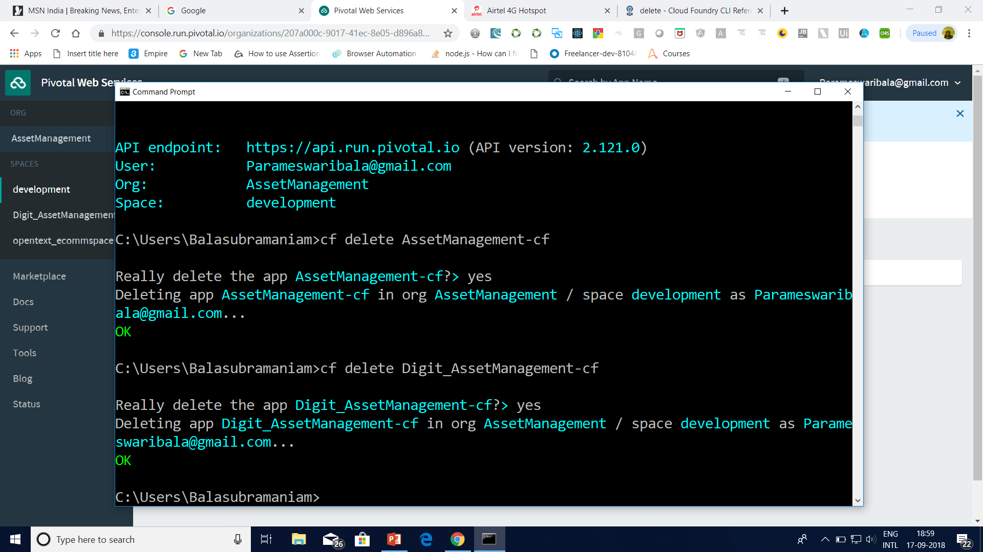

Slide 43
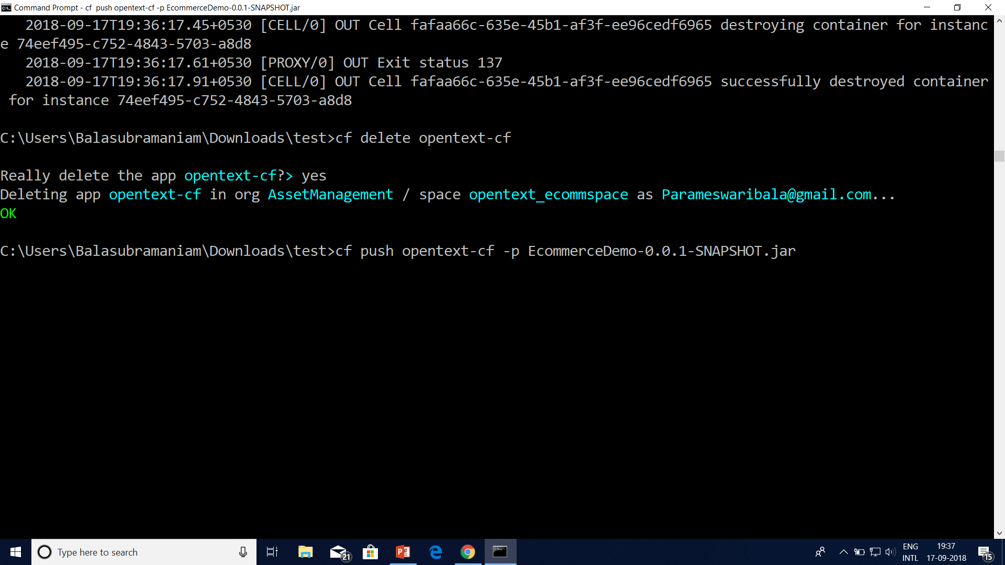

Slide 44
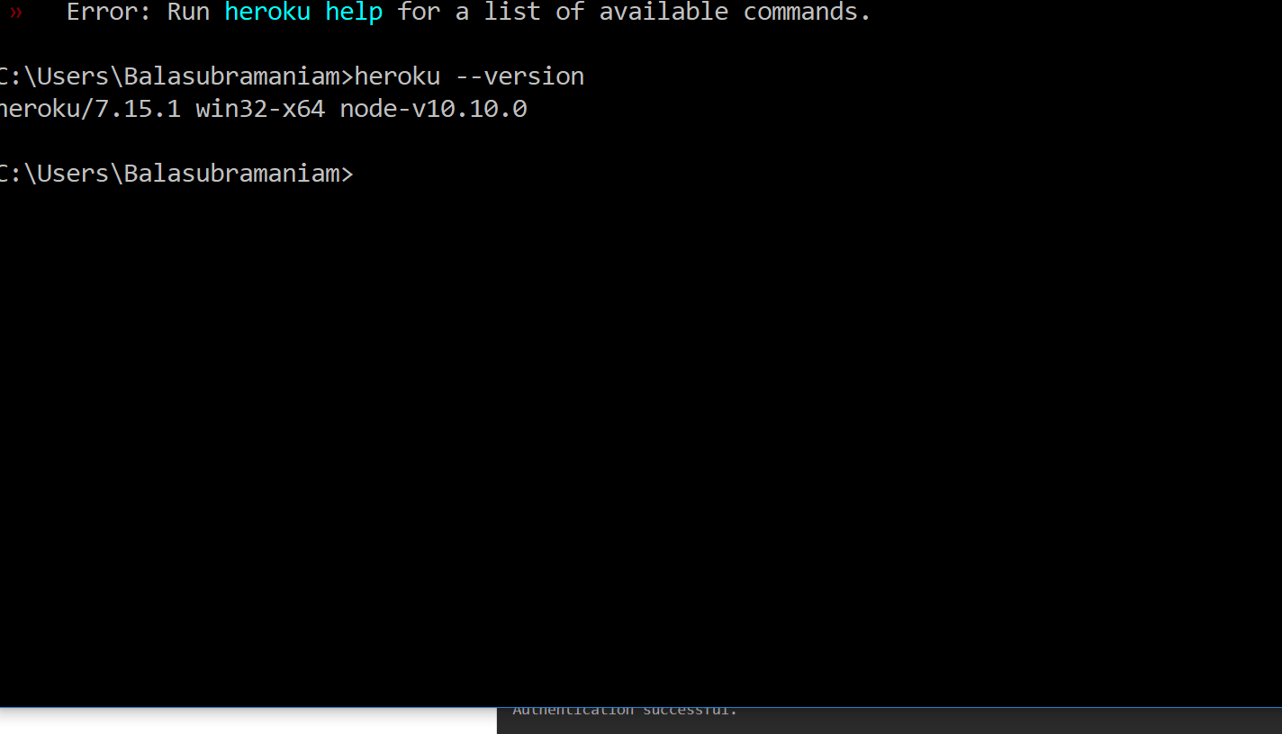
Heroku

Slide 45
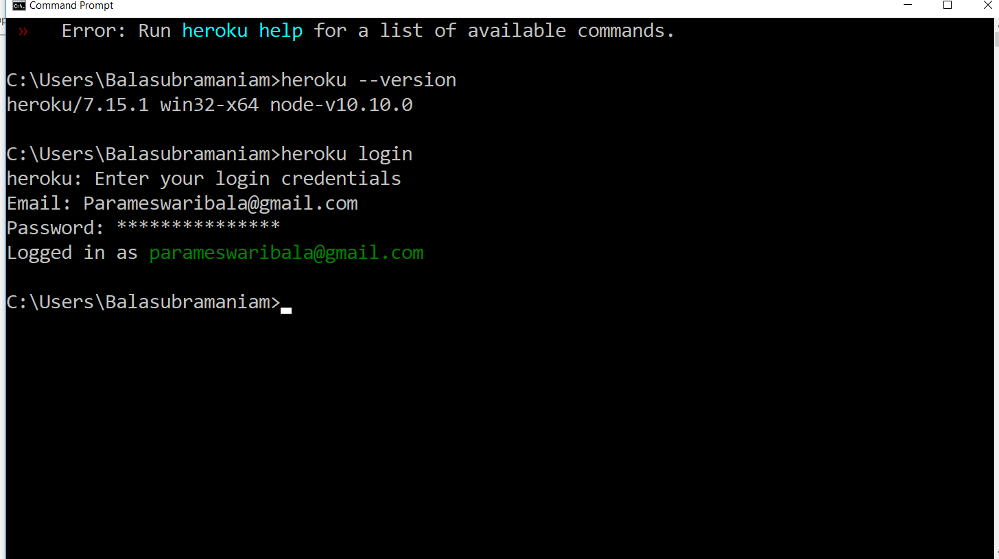

Slide 46
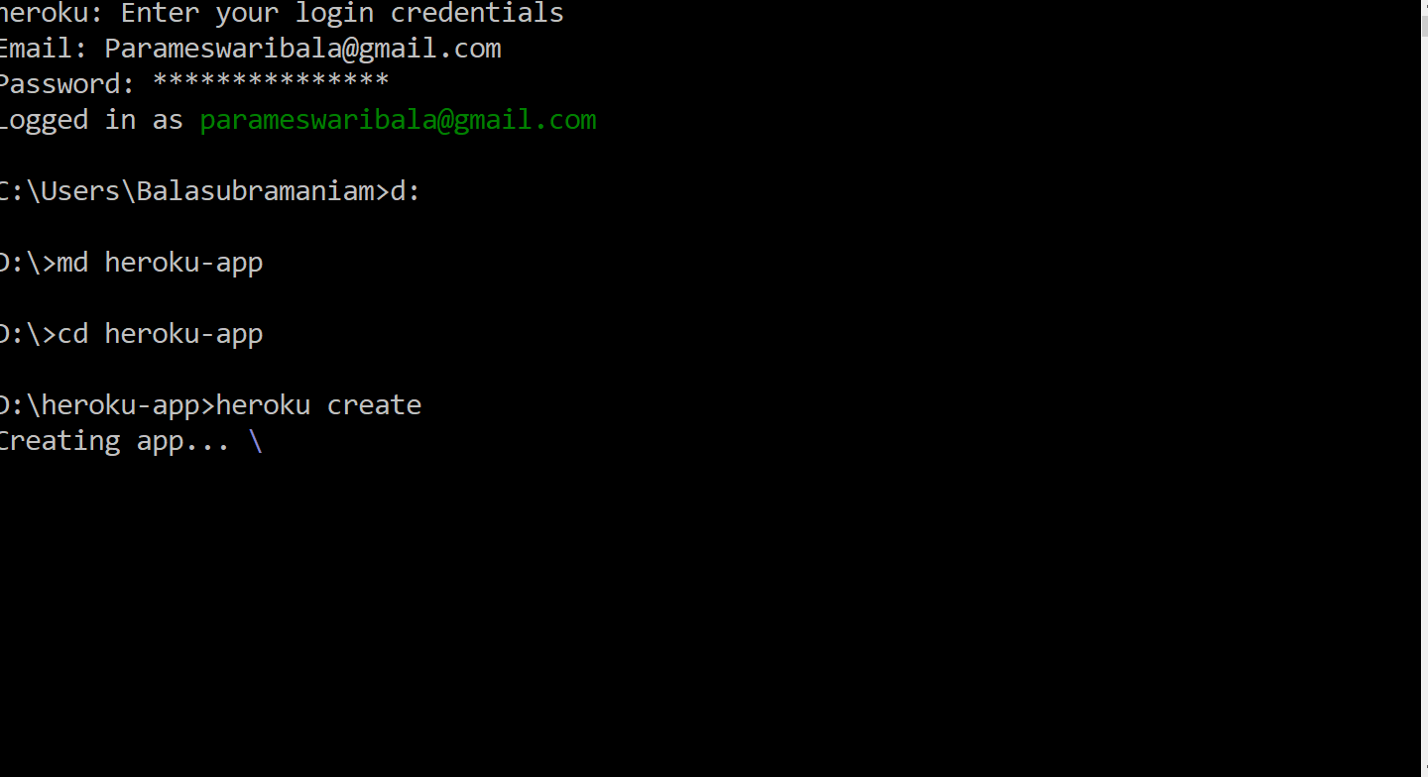

Slide 47
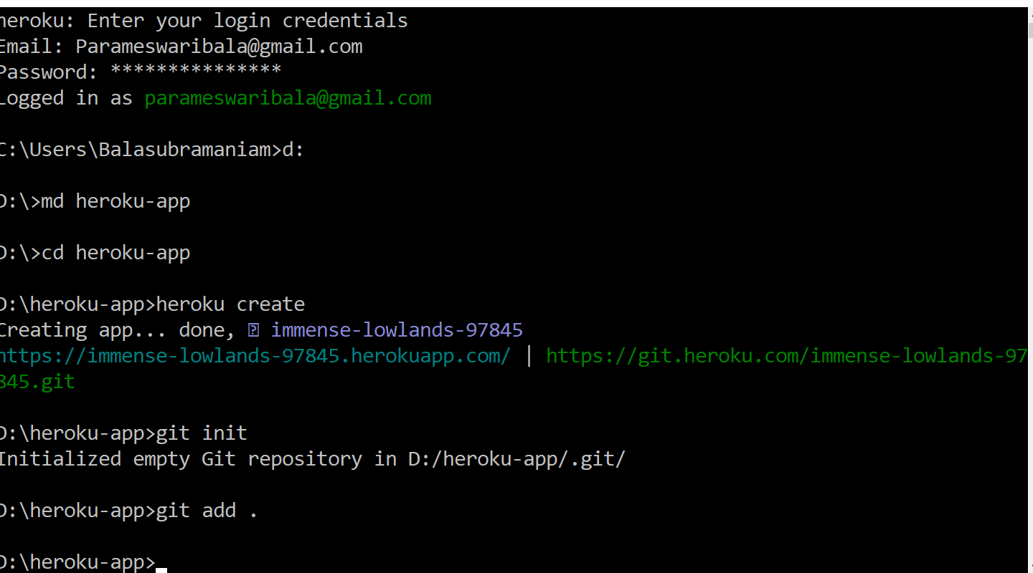

Slide 48
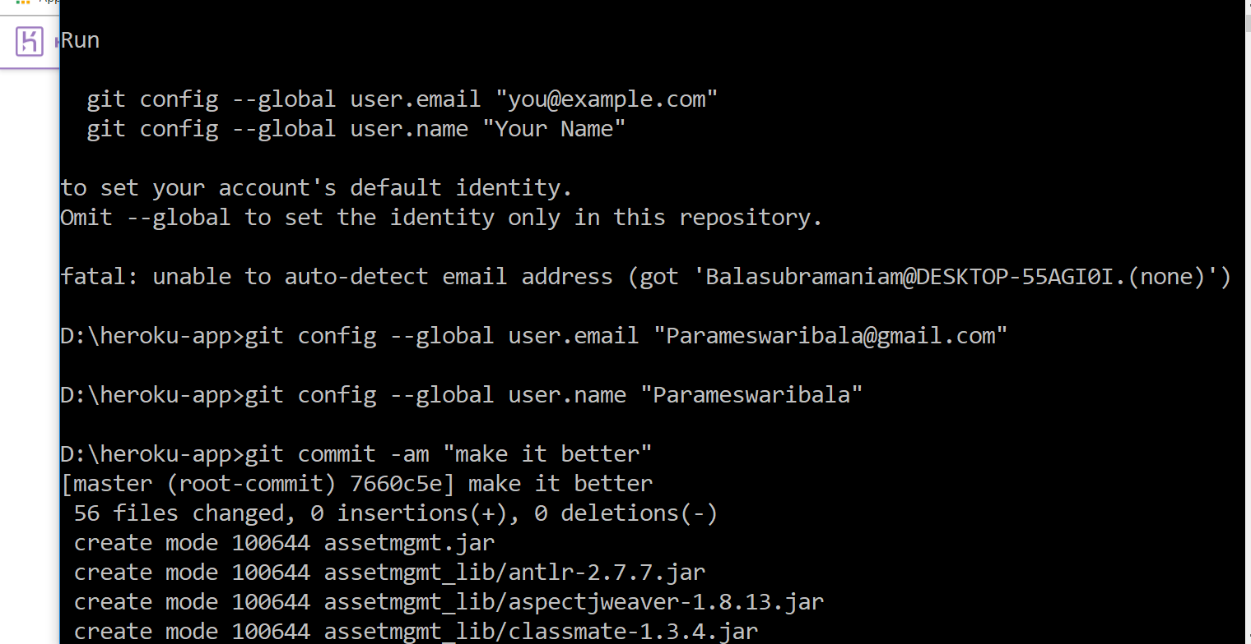

Slide 49
Using the Heroku Deploy CLI plugin
heroku addons:create heroku-postgresql:hobby-dev
heroku plugins:install heroku-cli-deploy
heroku create --no-remote
heroku deploy:jar target/my-app.jar --app sushi

Slide 50
Logging Configuration in Spring Boot
Date and Time: Millisecond precision and easily sort able.
Log Level: ERROR, WARN, INFO, DEBUG or TRACE.
Process ID.
A — Separator to distinguish the start of actual log messages.
Thread name: Enclosed in square brackets (may be truncated for console output).
Logger name: This is usually the source class name (often abbreviated).

Slide 51
Internationalization

Slide 52
Currently Available AutoConfiguration Behaviour
Data grid: Spring Data Gemfire, Solr and Elasticsearch
! Websocket
! Web services
! Mobile & Social (Facebook, Twitter and LinkedIn)
! Reactor for events and async processing
! Jersey
! JTA
! Email, CRaSH, AOP (AspectJ)
! Actuator features (Security, Audit, Metrics, Trace)

Slide 53
The Actuator
Actuator brings production-ready features to our application.
Monitoring our app, gathering metrics, understanding traffic or the state of our database becomes trivial with this dependency.
Actuator is mainly used to expose operational information about the running application – health, metrics, info, dump, env, etc. It uses HTTP endpoints or JMX beans to enable us to interact with it.
Once this dependency is on the classpath several endpoints are available for us out of the box. As with most Spring modules, we can easily configure or extend it in many ways.

Slide 54
The Actuator
Adds common non-functional features to your application and exposes endpoints to interact with them (REST, JMX)
• Secure endpoints: /env, /metrics, /trace, /dump, /shutdown, /beans, /
autoconfig, /configprops, /mappings
• /info
• /health
• Audit
If embedded in a web app or web service can use the same port or a different one
(management.port) and/or a different network interface (management.address)
and/or context path (management.context-path).

Slide 55
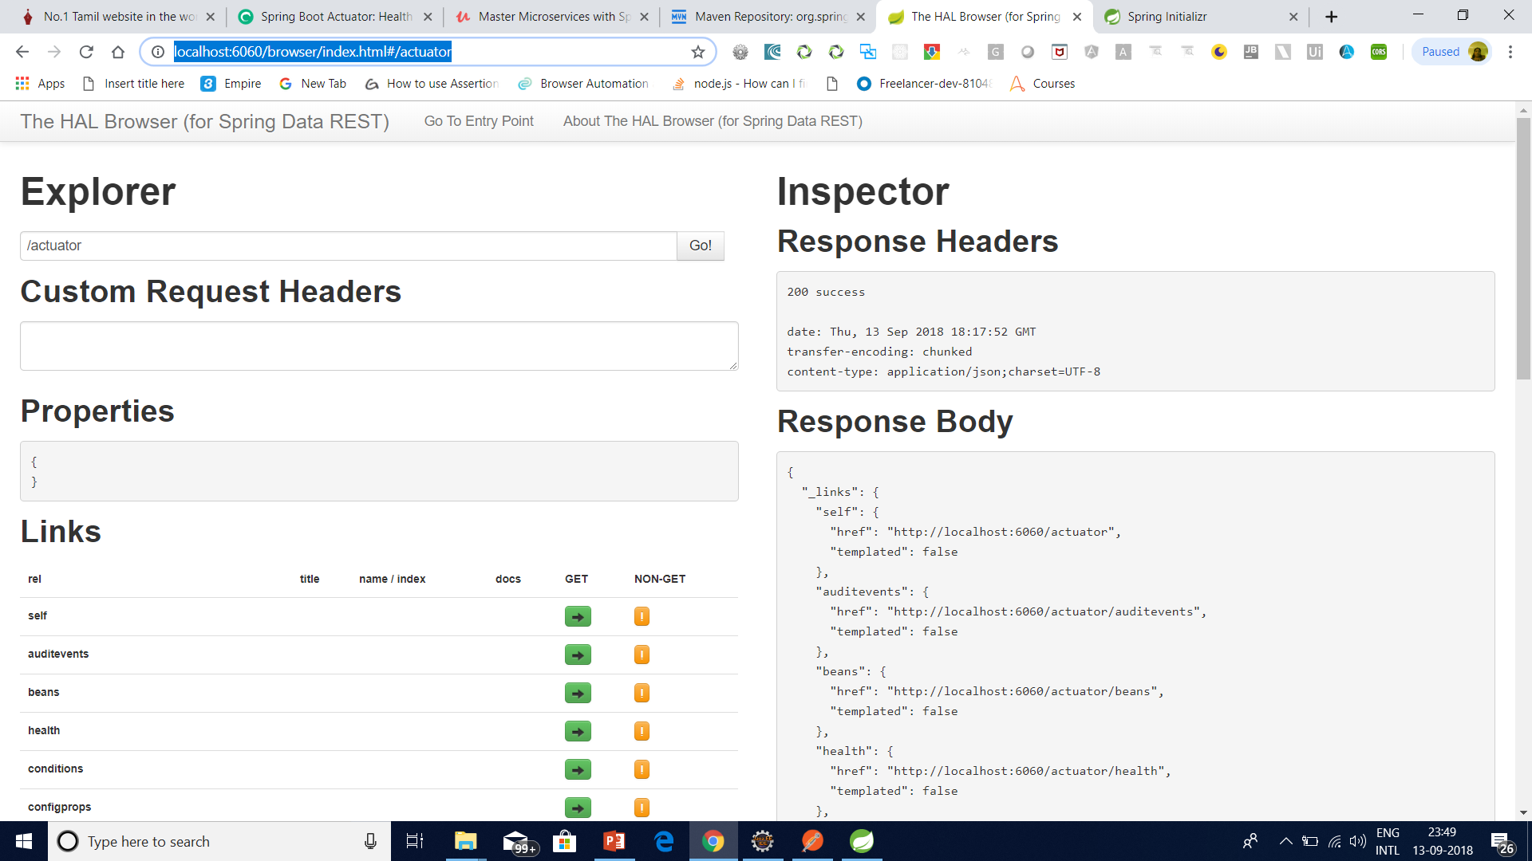
The Actuator – spring –data-hal-browser http://localhost:6060/browser/index.html

Slide 56
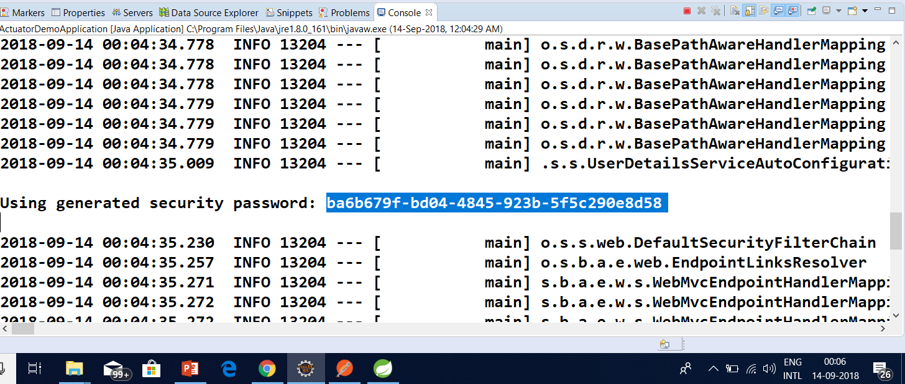
Spring Boot Security

Slide 57
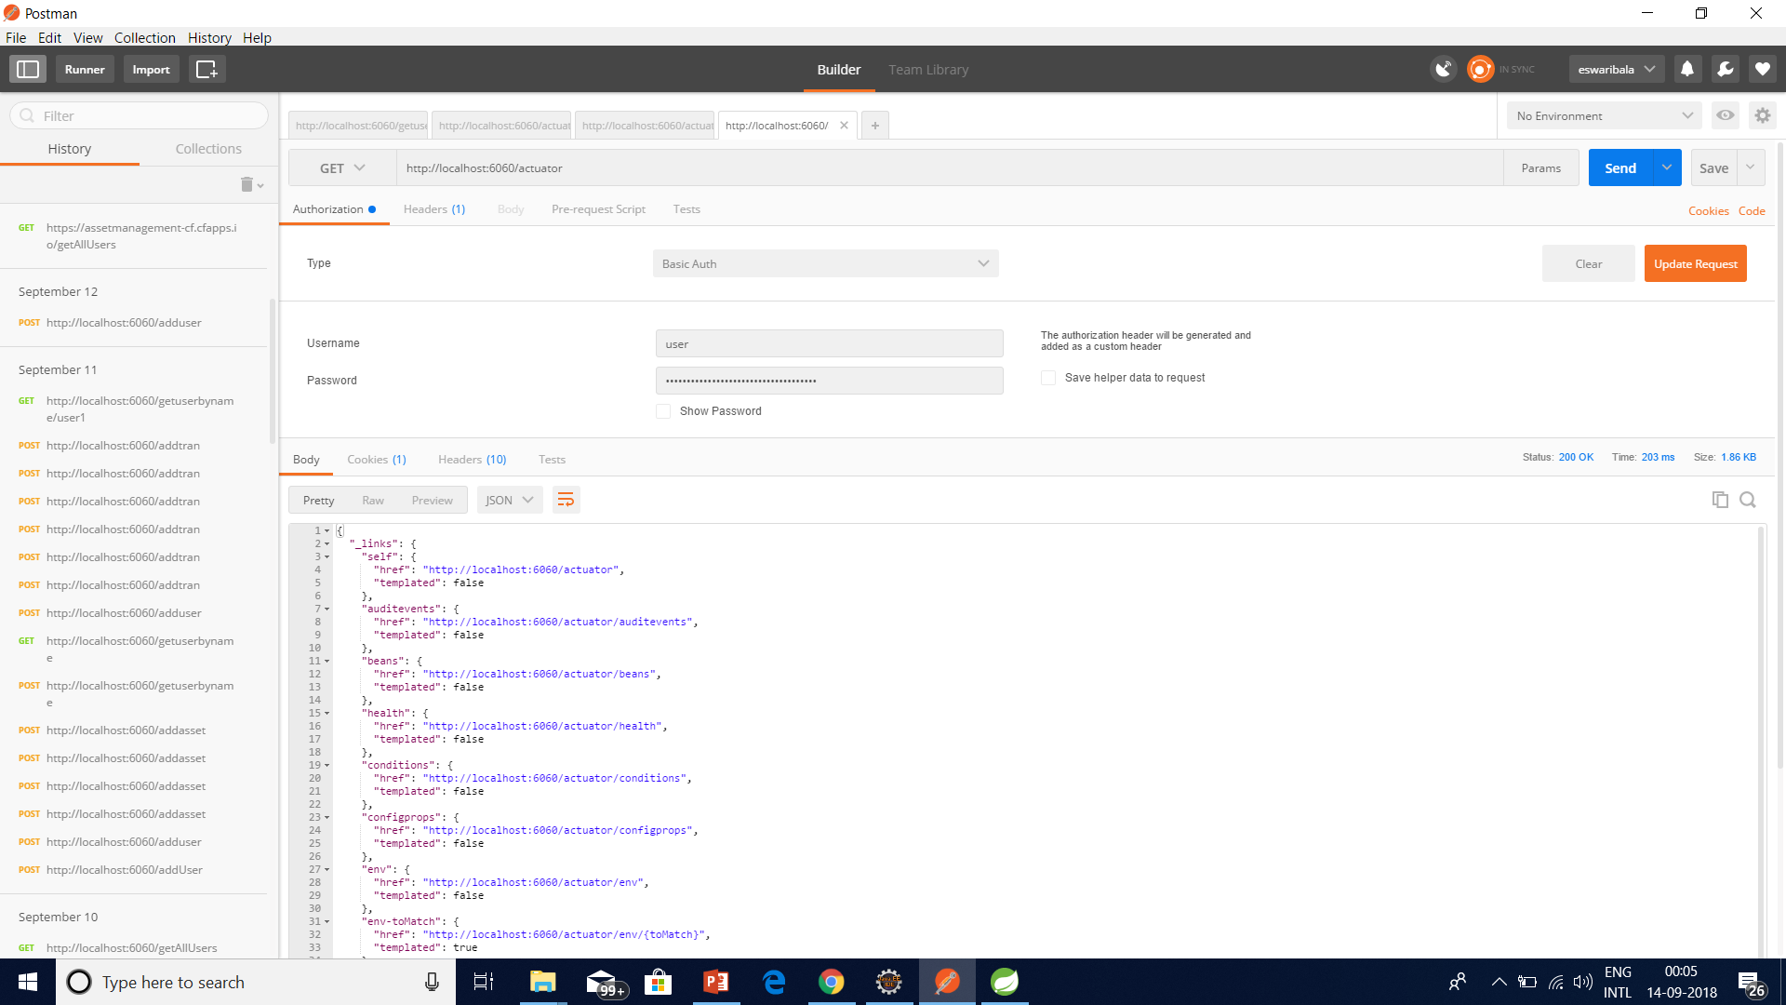
Spring Boot Security

Slide 58
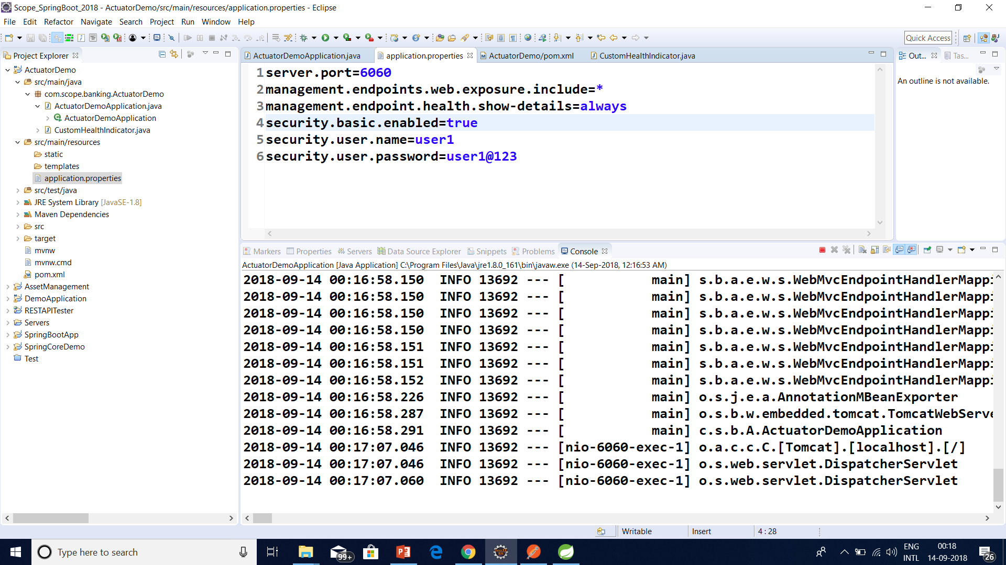
Spring Boot Security

Slide 59
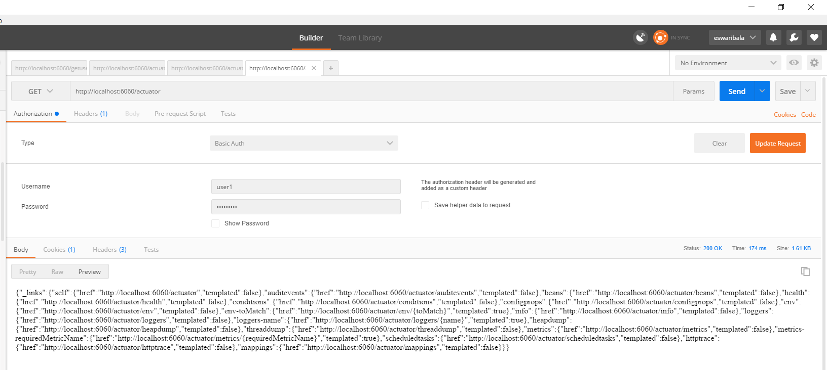
Spring Boot Security

Slide 60
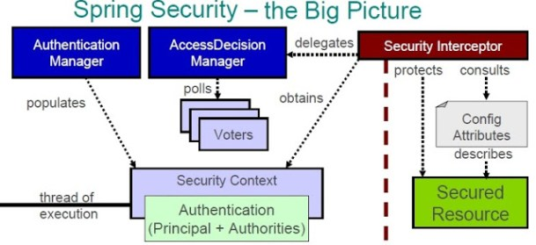
. SECURING AN APPLICATION WITH SPRING BOOT AND SPRING SECURITY

Slide 61
EnableGlobalMethodSecurity vs Enable Web Security
EnableGlobalMethodSecurity provides AOP security on methods, some of annotation it will enable are PreAuthorize PostAuthorize

Slide 62
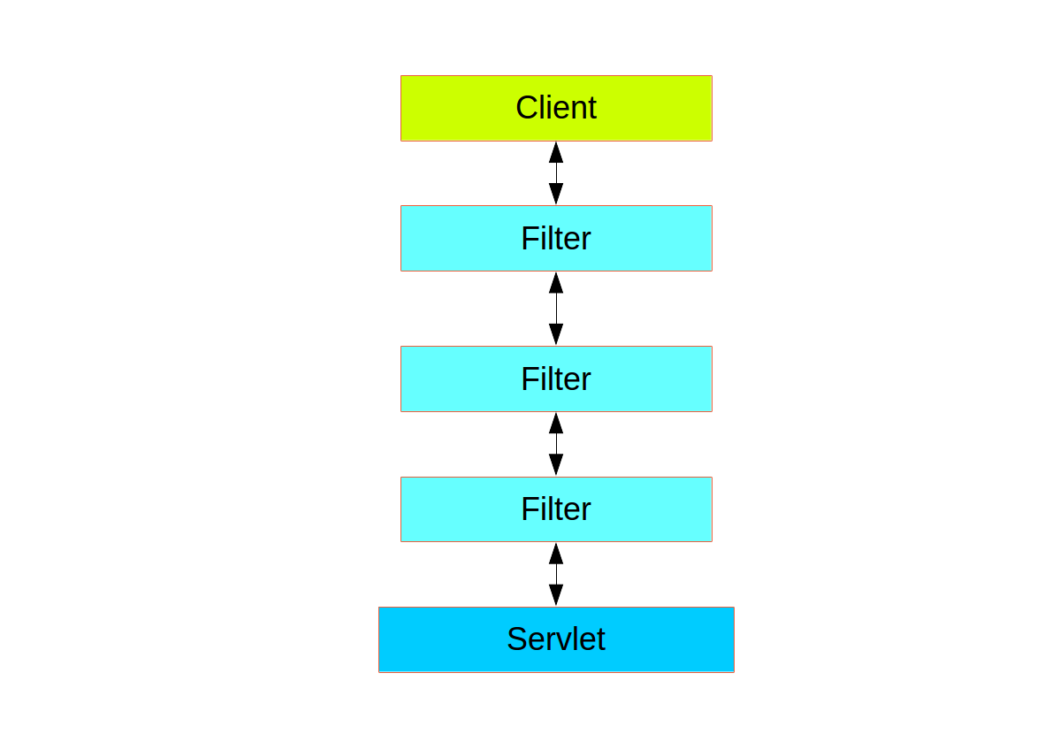
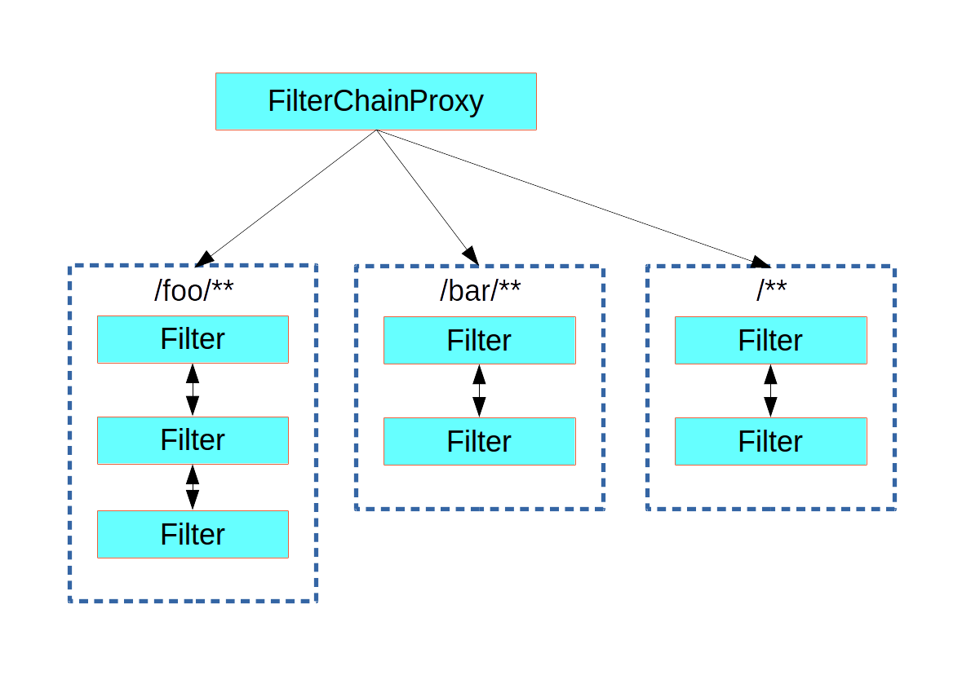
. SECURING AN APPLICATION WITH SPRING BOOT AND SPRING SECURITY

Slide 63
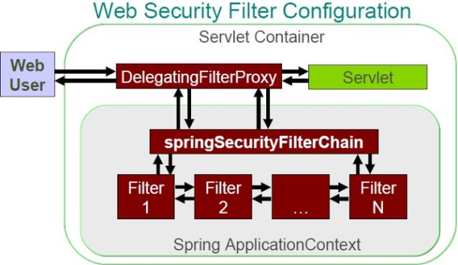
. SECURING AN APPLICATION WITH SPRING BOOT AND SPRING SECURITY

Slide 64
Questions

Slide 65
Module Summary
Spring Integration Framework.
Message, Channel and Adapter
Understood the different Component Integration
Understood the Event-Driven Architecture

